Slide 1
Technical Advisory Council (TAC) Overview
2025

Slide 2
LF Energy Foundation Overview and Governance

Slide 3
What is LF Energy?
LF Energy is the community for digital experts to collaborate on open industrial-grade technology platforms and agile standards that accelerate the energy transition.
We are part of the Linux Foundation, the largest shared technology investment in the world.

Slide 4
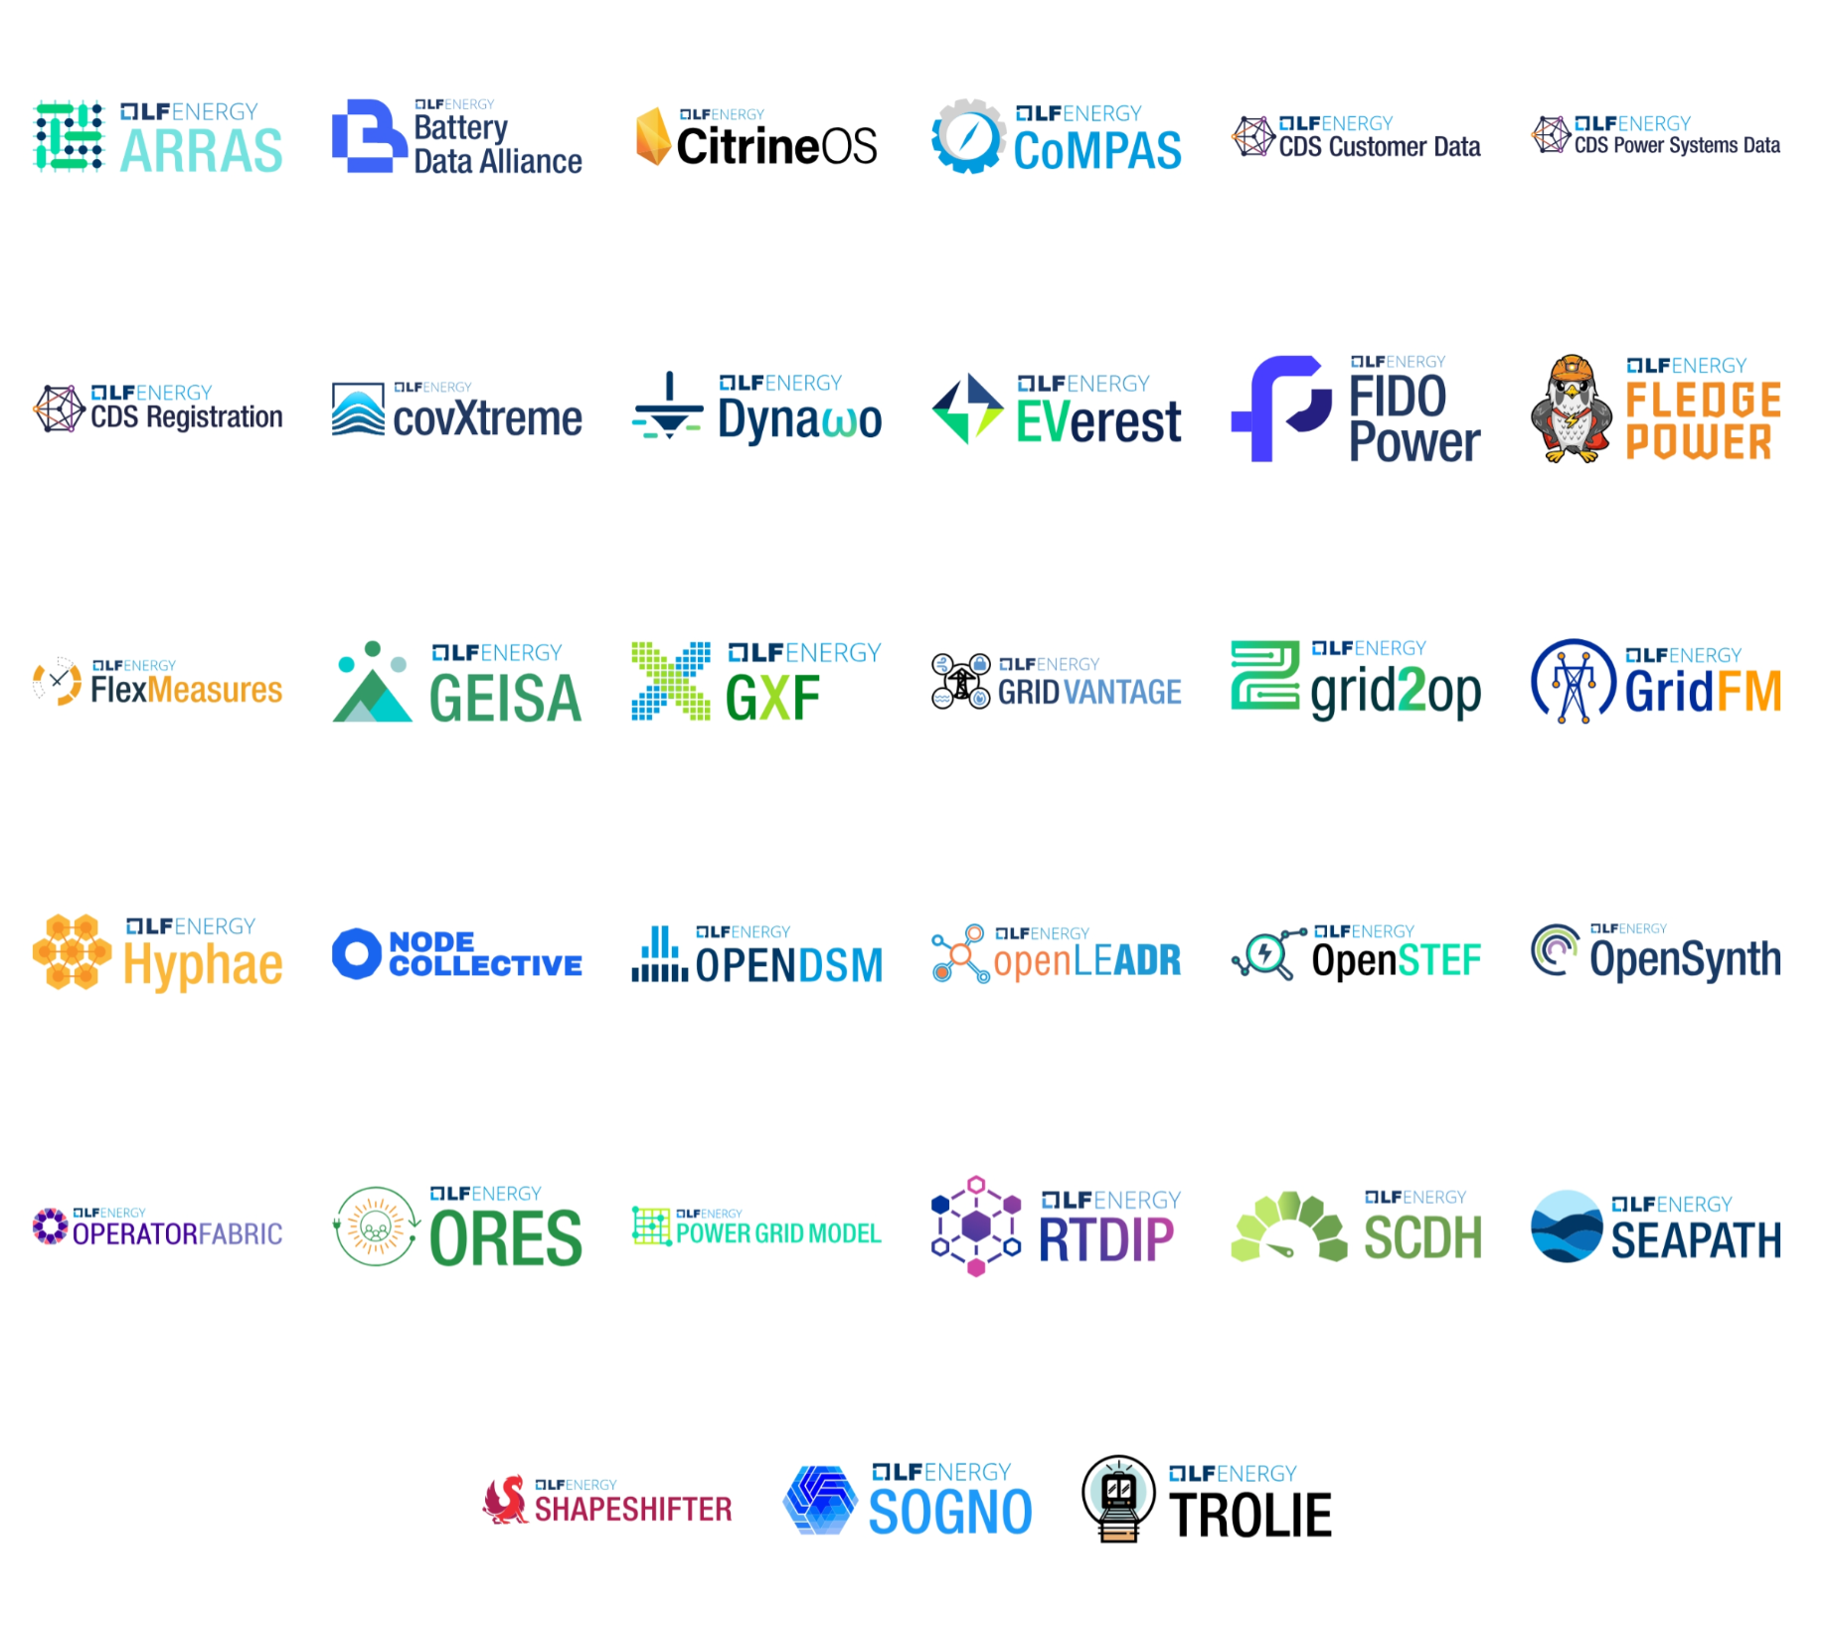
Projects
Notes:
Source: https://landscape.lfenergy.org/embed/embed.html?base-path=&classify=category&key=sig&headers=false&category-header=true&category-in-subcategory=false&title-uppercase=false&title-alignment=center&title-font-family=sans-serif&title-font-size=13&style=clean&bg-color=%23009ade&fg-color=%23ffffff&item-modal=false&item-name=false&size=lg&items-alignment=center&items-spacing=0

Slide 5
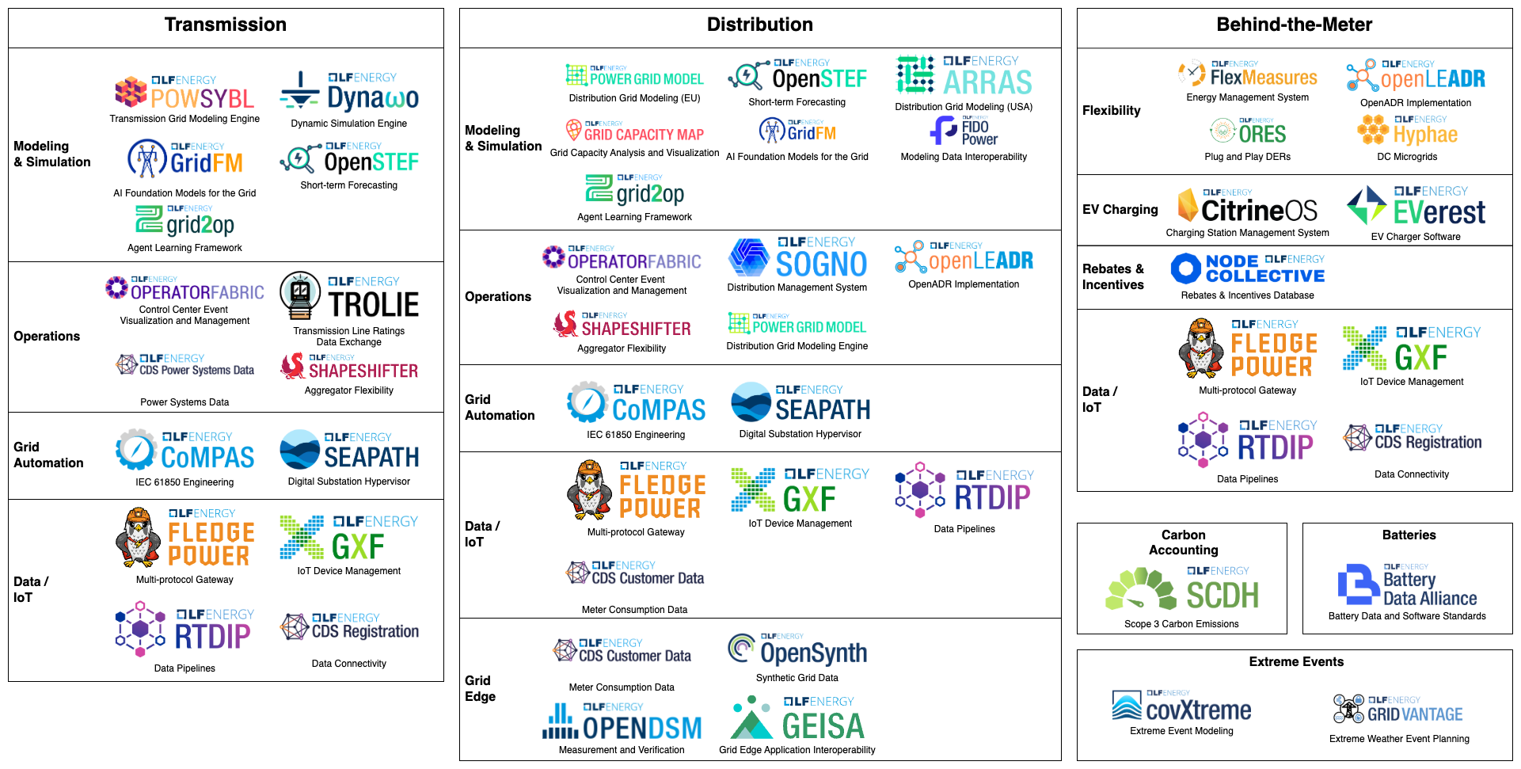
Project Landscape

Slide 6
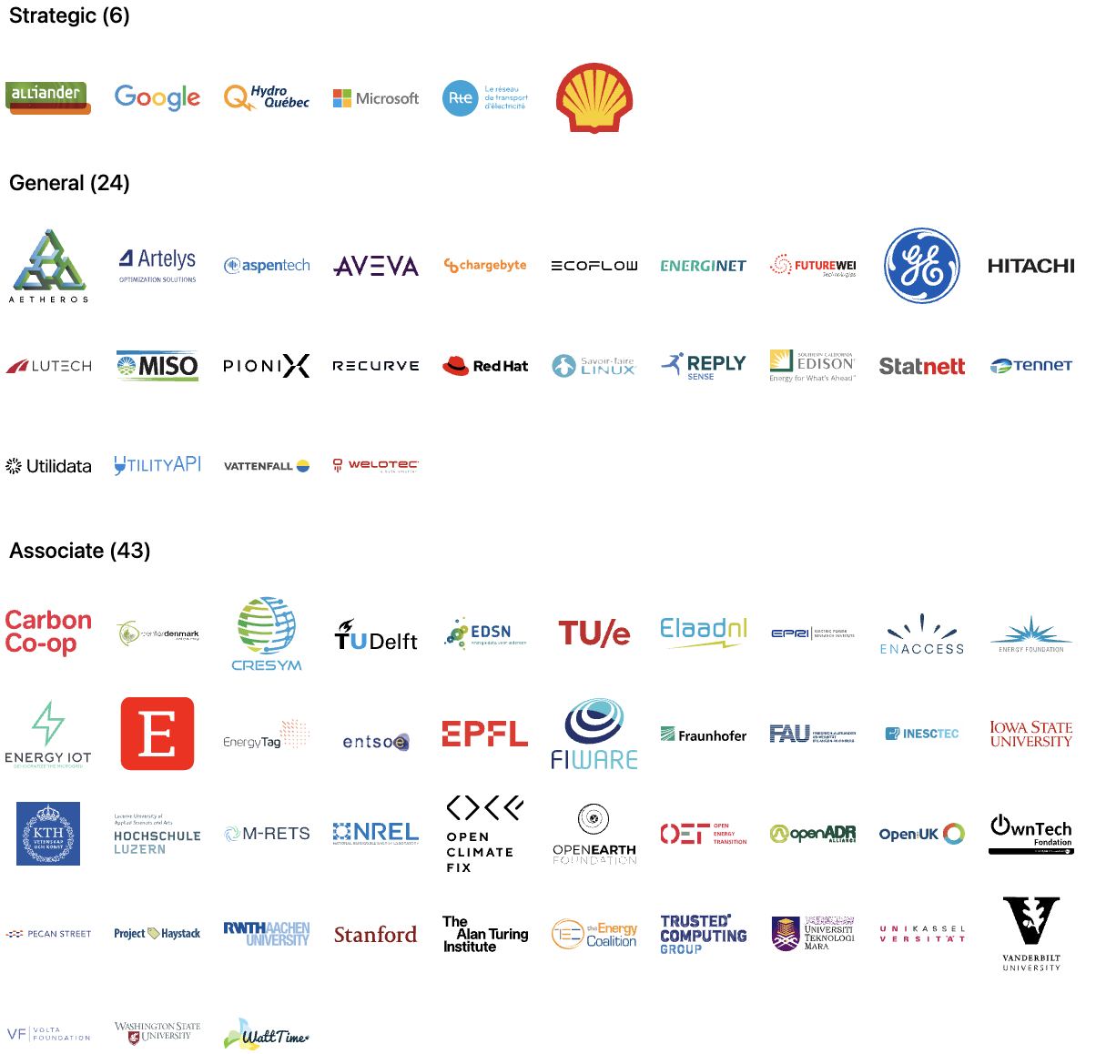
Members
Notes:
Source: https://landscape.lfenergy.org/embed/embed.html?base-path=&classify=category&key=lf-energy-member&headers=true&category-header=false&category-in-subcategory=false&title-uppercase=false&title-alignment=left&title-font-family=sans-serif&title-font-size=24&style=clean&bg-color=%23ffffff&fg-color=%23000000&item-modal=false&item-name=false&size=md&items-alignment=left

Slide 7
We’re a nonprofit, but not separately incorporated
The LF Energy Foundation is part of the the Linux Foundation and is not a separate legal entity
Therefore, the LF Energy Foundation Governing Board is not a corporate board of directors, and is not subject to corporate law statutes (e.g., those that govern fiduciary duties and how corporate boards of directors must operate)
The powers and duties of the Governing Board are set forth in the LF Energy Foundation Charter

Slide 8
Governance at a Glance
Fiduciary Governance - Membership driven
Technical Governance - Open to all
Governing Board
Technical Advisory Council (TAC)
Budget Committee
LF Energy Standards and Specifications (LFESS)
Steering Committee
Technical Projects
Working Groups/SIGs
Marketing Advisory Committee (MAC)
Standards
Working Groups

Slide 9
TAC Responsibilities

Slide 10
TAC Responsibilities
The TAC’s responsibilities include:
Setting an overall technical vision for the LF Energy Foundation
Approving new projects and working groups;
Overseeing the Project Lifecycle;
Enabling collaboration between projects and working groups;
Making recommendations to the Budget Committee for any resource needs;
Voting on other decisions that come before the TAC.
Additional responsibilities are described in Section 8 of the LF Energy Foundation Charter.

Slide 11
What the TAC is NOT responsible for
The TAC does not manage the day-to-day activities and operations of hosted projects and working groups, such as committer rights, release schedules, and roadmaps.
The TAC is not responsible for overseeing day-to-day operations of LF Energy Foundation. This is the responsibility of the foundation staff.
The TAC does not directly manage the overall budget for the LF Energy Foundation. The TAC makes resource recommendations to the Budget Committee and Governing Board, and provides feedback on the use of those resources.

Slide 12
TAC Operations

Slide 13
TAC Composition
The TAC voting members consist of:
One representative appointed from each Strategic member; and
One representative appointed by the TSC of each project
See Section 8(b) of the LF Energy Foundation Charter for more information about composition.
You can change your representative at any time by making a request at members.lfenergy.org.

Slide 14
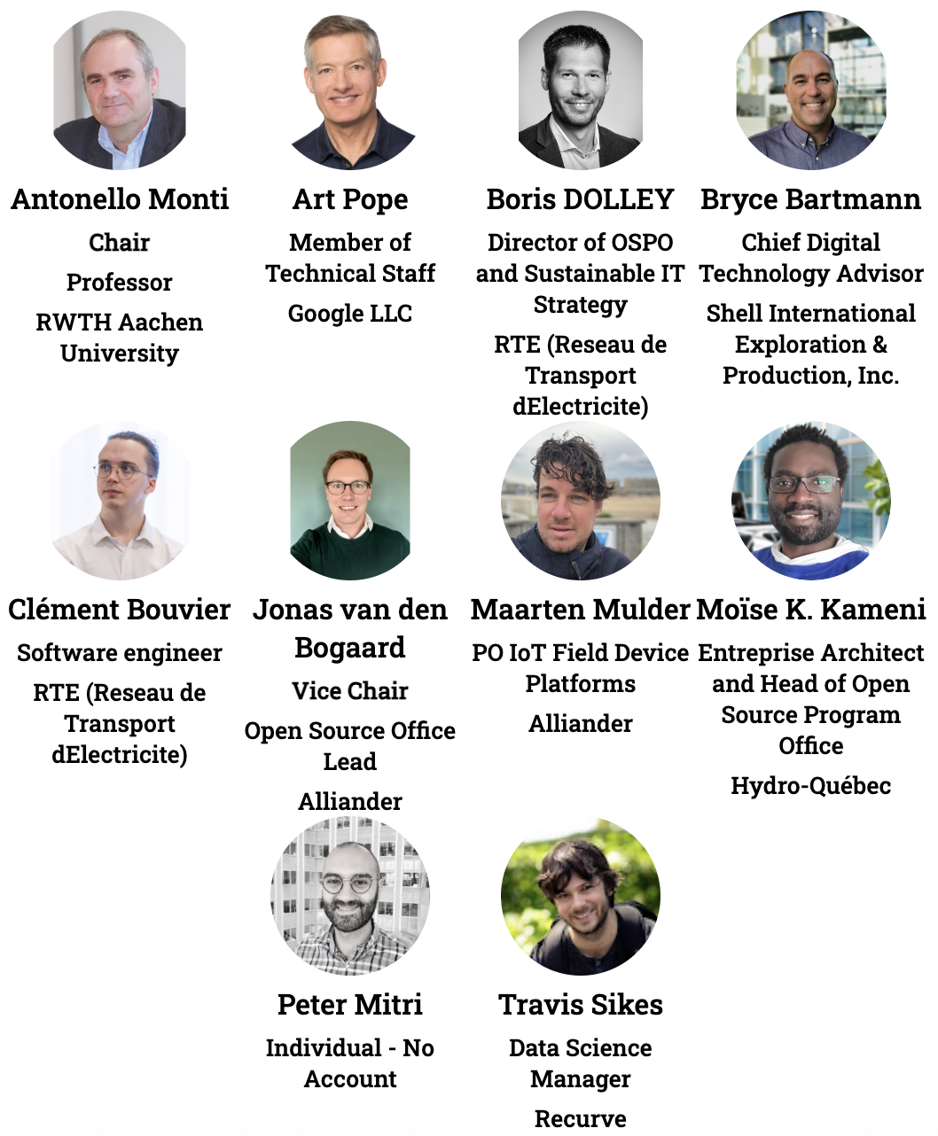
Technical Advisory Council (TAC)
voting representatives
Notes:
https://jmertic.github.io/committee-gallery/lf-energy-foundation-tac
Zoom to fit

Slide 15
TAC Chairperson
Annually in December, the TAC will elect a chairperson to serve for the subsequent year. Duties of the TAC Chairperson include:
Leading the strategy for setting an overall technical vision for the LF Energy Foundation
Preparing the agenda for and leading TAC meetings, with the support of the foundation staff ( generally meets with the staff on a regular basis to align on topics and priorities )
Serving as a voting member of the Governing Board to represent the TAC and larger technical communities.
Be a spokesperson for the TAC and larger technical community, as needed
See Section 8(a) of the LF Energy Foundation Charter for more information about the chairperson role.

Slide 16
TAC Meetings

Slide 17
Meeting Cadence
The TAC has virtual meetings, generally monthly on the second Tuesday of the month. All meetings are public meetings unless specified otherwise.
Format for the meetings generally include short updates, and up to three larger topics ( such as an annual review of a project/working group, new project/working group proposal, larger discussion item, or special presentation )
Voting will often take place at each meeting
If you cannot attend a meeting and wish to have someone else represent you, please contact the foundation staff at members.lfenergy.org.
Additionally, the TAC may have one hybrid Leadership Meetings session per year.
Governing Board representatives and a representative from each General Member are invited to Strategy Sessions.
In rare and exceptional circumstances (e.g., in an emergency situation), an additional ad hoc special meeting of the TAC may be convened.
To request a special meeting, please email your request to the Foundation Staff and TAC Chair, and they will decide whether a special meeting is necessary or the proposed agenda item can be discussed by email or at the next regular meeting.

Slide 18
How to propose an agenda item
Agenda for TAC meetings are managed at https://github.com/orgs/lf-energy/projects/2
Propose a topic for a TAC meeting at https://github.com/lf-energy/tac/issues/new/choose
Please submit your proposed agenda item at least 7 days prior to the meeting.
Please be patient. TAC meeting agendas are often quite full, and the length of the meeting only allows the time for two larger topics per meeting, so if your topic is more than a short topic it may not scheduled for the next meeting.

Slide 19
Proposing an agenda item (continued)
If we cannot accommodate your request in the upcoming meeting we may:
Wait until the following meeting to discuss the topic
Call a special meeting to discuss your topic, or
Refer the topic to the appropriate committee or task force of the TAC
We may ask you to provide slides 3 days before the meeting.

Slide 20
TAC Materials
Agendas for TAC meetings will be made available the day before the scheduled meeting
Past meeting notes can be found here.
No meeting of the TAC is recorded unless the TAC provides explicit consent to do so.

Slide 21
Discussion Channels
Relevant Mailing Lists
TAC Public List: tac@lists.lfenergy.org
TAC Private List: tac-voting@lists.lfenergy.org
This list is ONLY for sensitive topics and voting
Project and Working Group Leads: technical-project-leads@lists.lfenergy.org
Slack Channel
You can join LF Energy slack here.
To join the TAC slack channel, make a request at members.lfenergy.org.

Slide 22
Policies and Other Resources

Slide 23
Important LF Energy Foundation Policies and Resources
LF Energy Foundation Charter
Linux Foundation Antitrust Policy
Foundation GitHub repository with many other public facing policies and materials including…
Elections Process
LF Energy Foundation hosted project charters, which define each project’s intellectual property and licensing policies.
LF Energy Landscape
High Level Overview

Slide 24
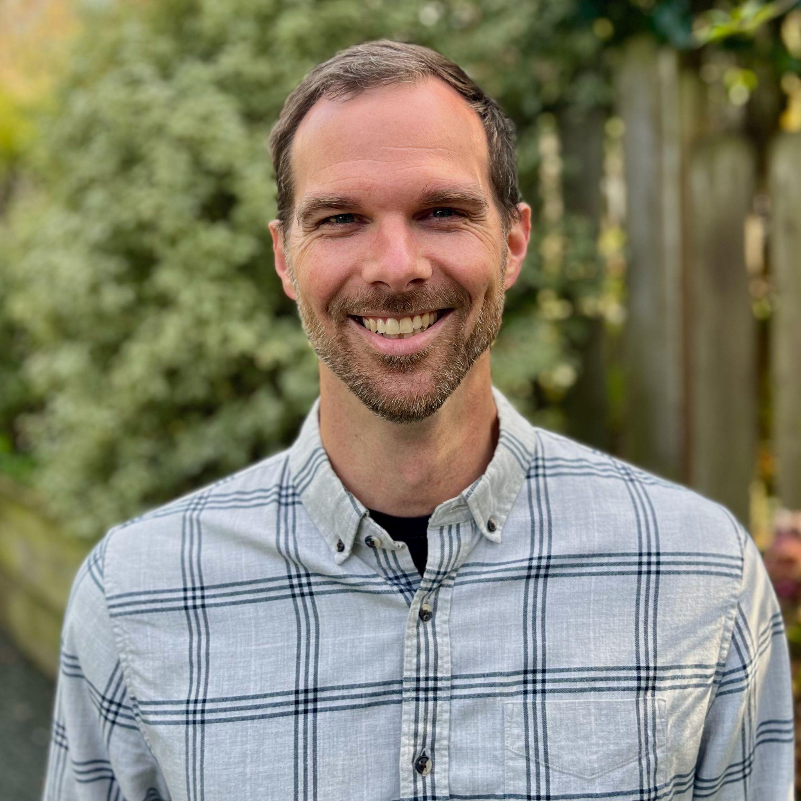
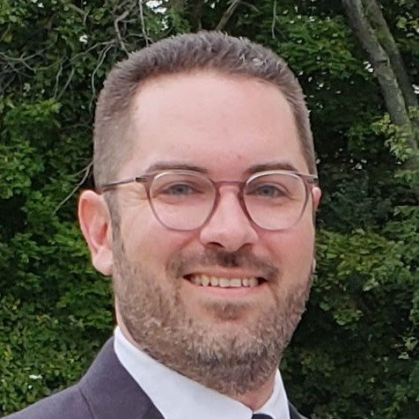
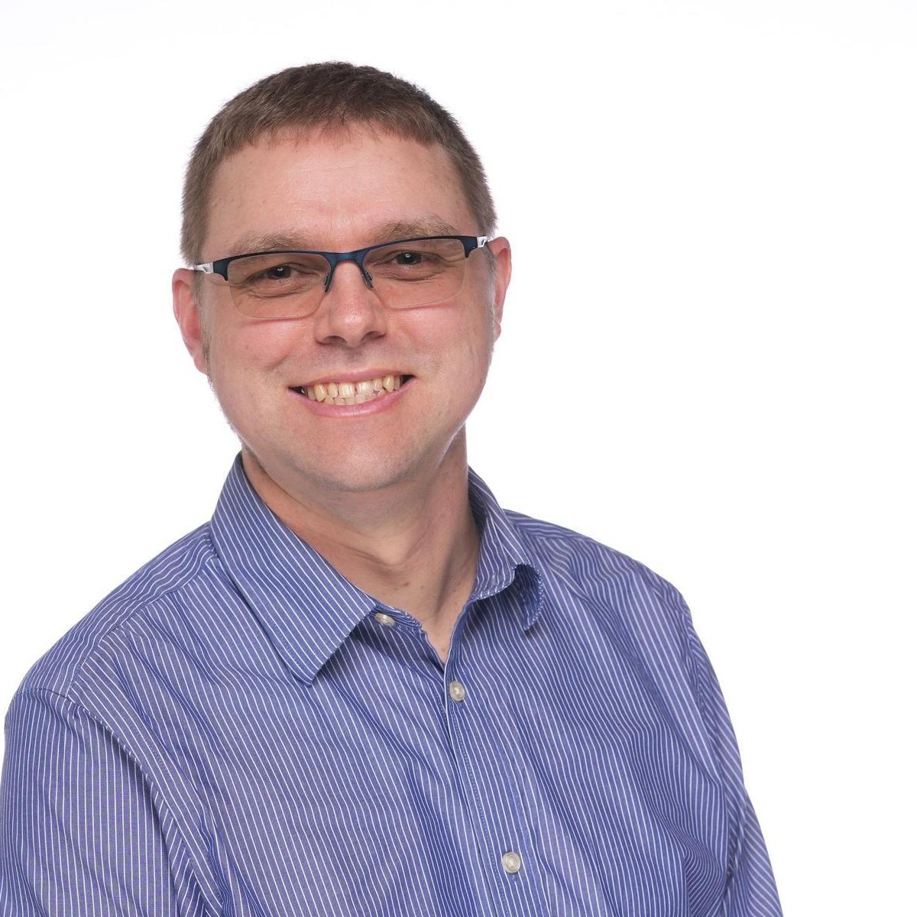

LF Energy staff
Alex Thornton, LF Energy Executive Director
Dan Brown, Marketing Director
John Mertic, Program Director
Yarille Ortiz, Sr. Project Coordinator
Support requests for the staff can be made at support.lfenergy.org.

Slide 25
LFX Organization Dashboard
LFX Organization Dashboard provides access to key membership materials, including…
Member contacts, which you can change at any time ( look under ‘Users’ > and then under the ‘Key People’ tab )
Membership details ( look under ‘Membership’ > ‘LF Energy Foundation’ ), including…
Membership Overview Deck and High Level Overview Deck ( look under the ‘Resources’ tab )
Your fully executed membership agreement ( look under the ‘Membership’ tab )
Details on how to leverage membership benefits ( look under the ‘Benefits’ tab )
Insights on contributors from your organization ( look under the ‘Project Contributors’ tab )
ACTION: Request access to LFX Organizational Dashboard here.

Slide 26
Who’s Who in the LF Energy Foundation
LF Energy Foundation Members
Staff: LF Energy Foundation Staff, Linux Foundation Leadership
Governing Board Members
Technical Advisory Council Members
LF Energy Project and Working Group Leads

Slide 27
Thank you!
If you have any questions, feel free to contact the staff at members.lfenergy.org.

